Slide 1

Lab 4: Instrumentation Lab
PHY2049L
Section: 016

Slide 2
Learning Outcomes
Student will demonstrate the linear nature of Ohm’s Law, comparing the experimental resistance values to the nominal color code values.
Students will learn how a circuit breadboard is connected.
Gain experience with various multimeters to measure current and voltage.
Set up a simple resistor circuit.

Slide 3
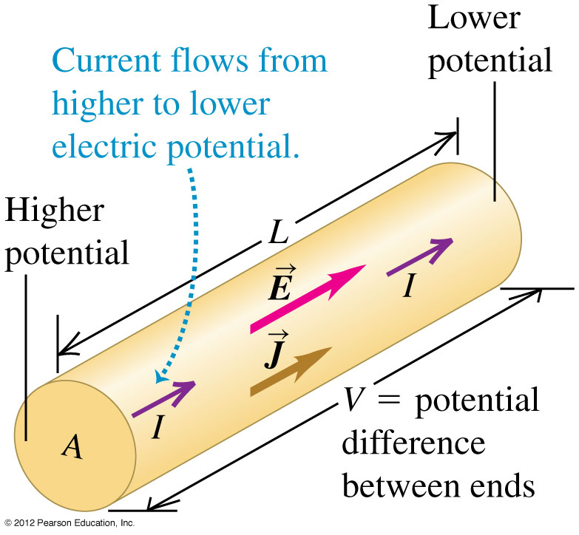
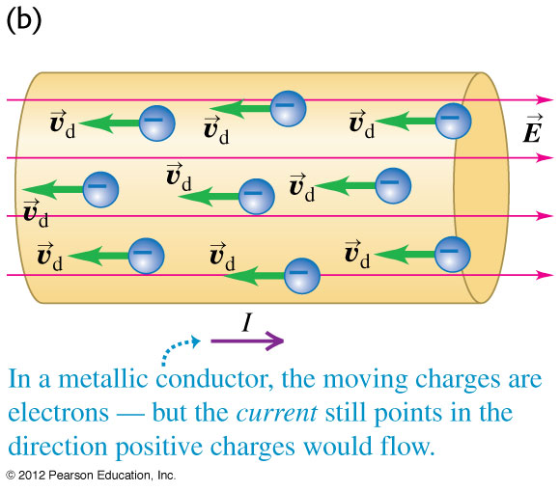
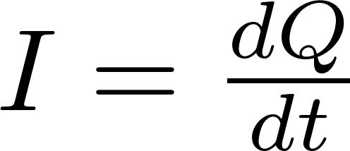
Electric Current
Current is defined as the motion of charge from one region to another. Negatively charged electrons flow freely in metals (like copper).
Negative charges will move in a direction opposite to the direction of an applied Electric field.
The electric field does work on the charged particles.
Current in measured in units of Amperes(A).

Slide 4
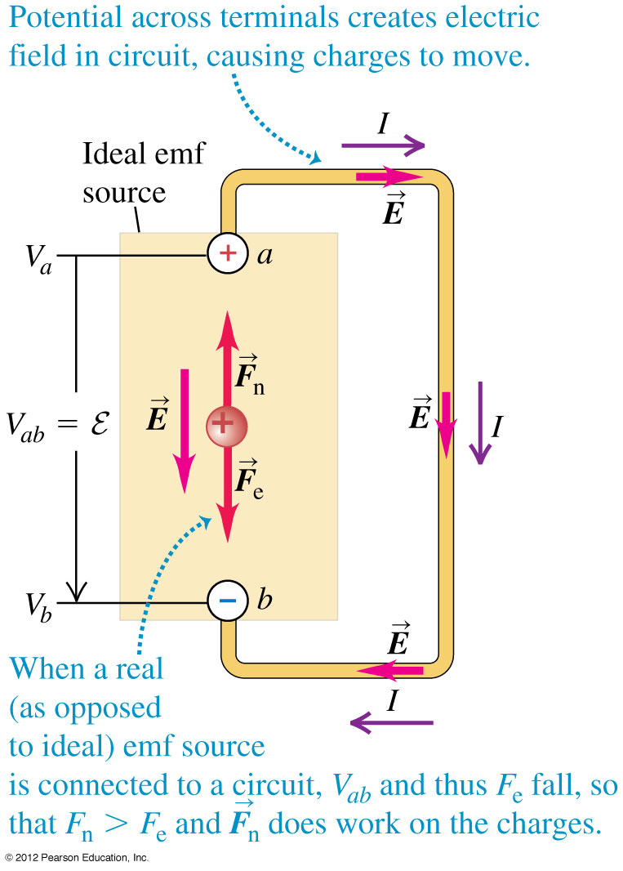
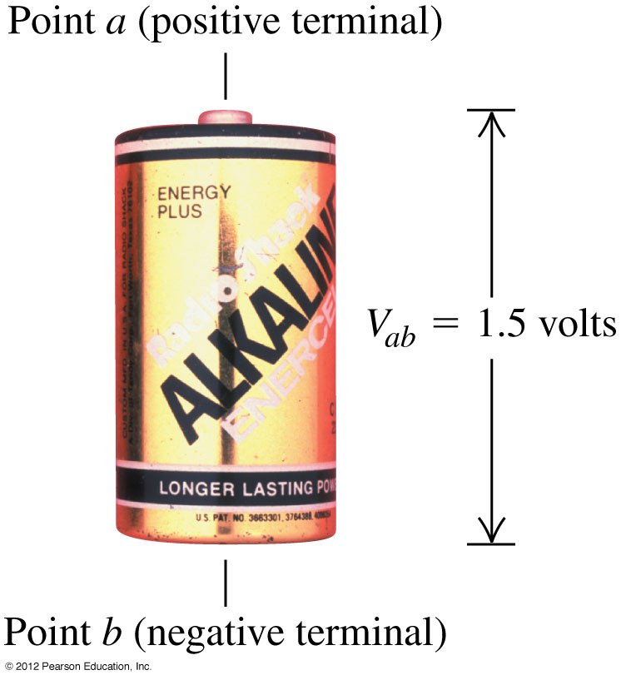

Electric Potential
Electric Potential is potential energy per unit charge. It has the units of Volts (V).
Electric Potential energy can be thought of as the work that must be done to move a charge from point b to a in an electric field.
Mainly we care about potential differences.
Potential difference represents the work that is done by the electric field when a charge moves from a to b. Or alternatively, the work that must be done to move a unit charge slowly from b to a against an electric force.

Slide 5
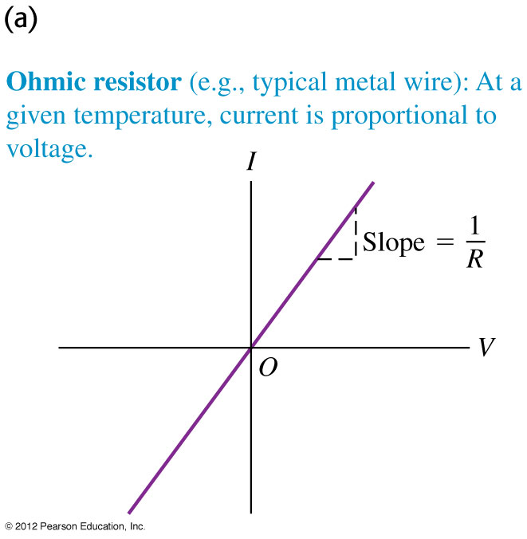
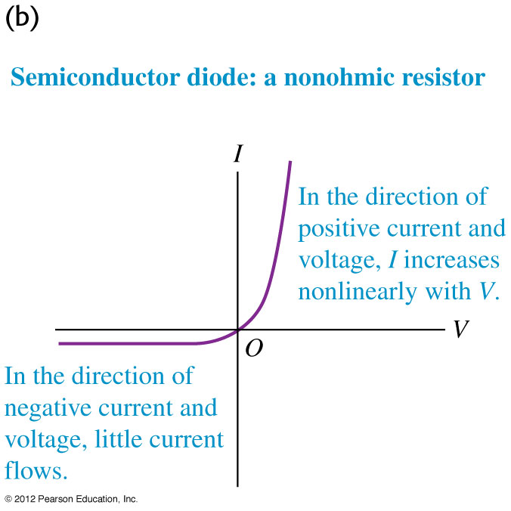

Resistance and Ohm’s Law
Defined ratio of the applied voltage, and the amount of current flowing through a conductor. This is known as Ohm’s Law.
Ohm’s Law is not valid for all materials (like diodes/semiconductors).

Slide 6
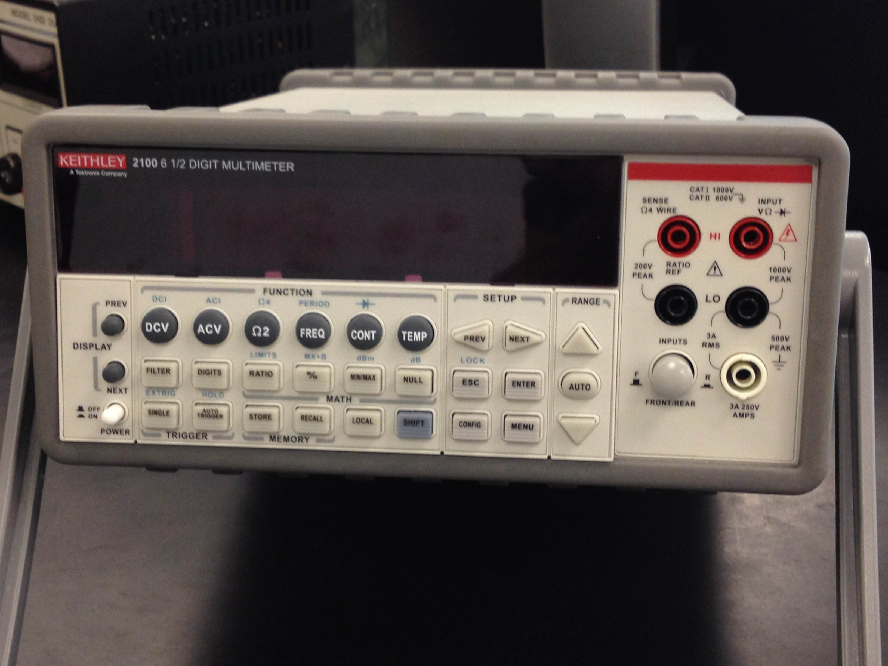
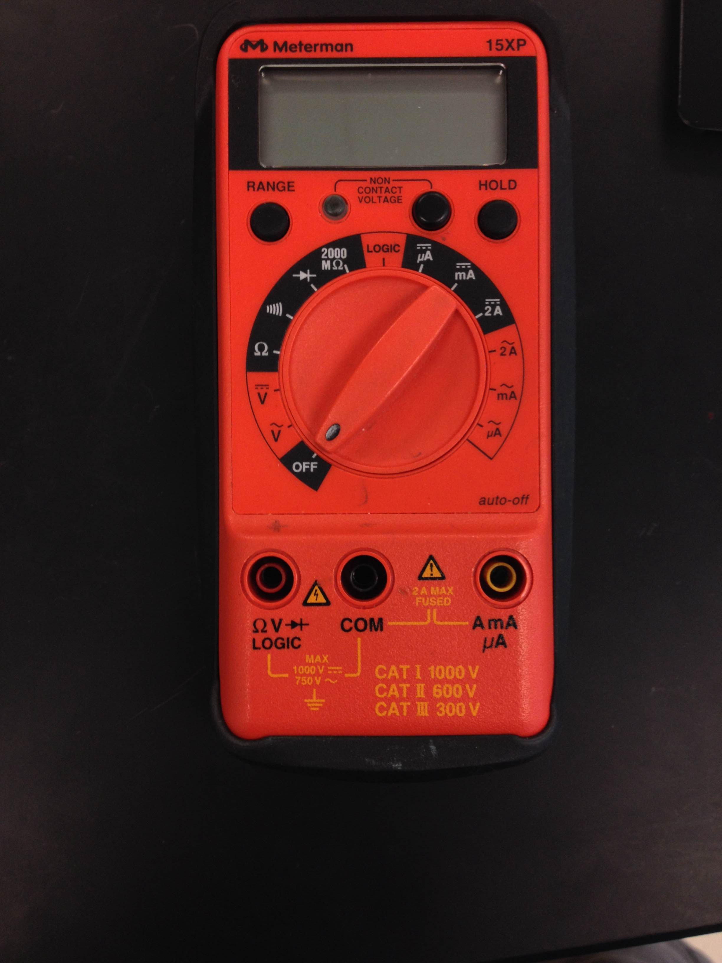
Multimeters
There are many kinds of multimeters, but we will focus on two.
Handheld
Keithley Digital Multimeter.

Slide 7
Handheld
This setting will allow you to check continuity.
Measure Current
Measure Voltage
These two ports must be used to measure CURRENT.
These two ports must be used to measure voltage, continuity and resistance.

Slide 8
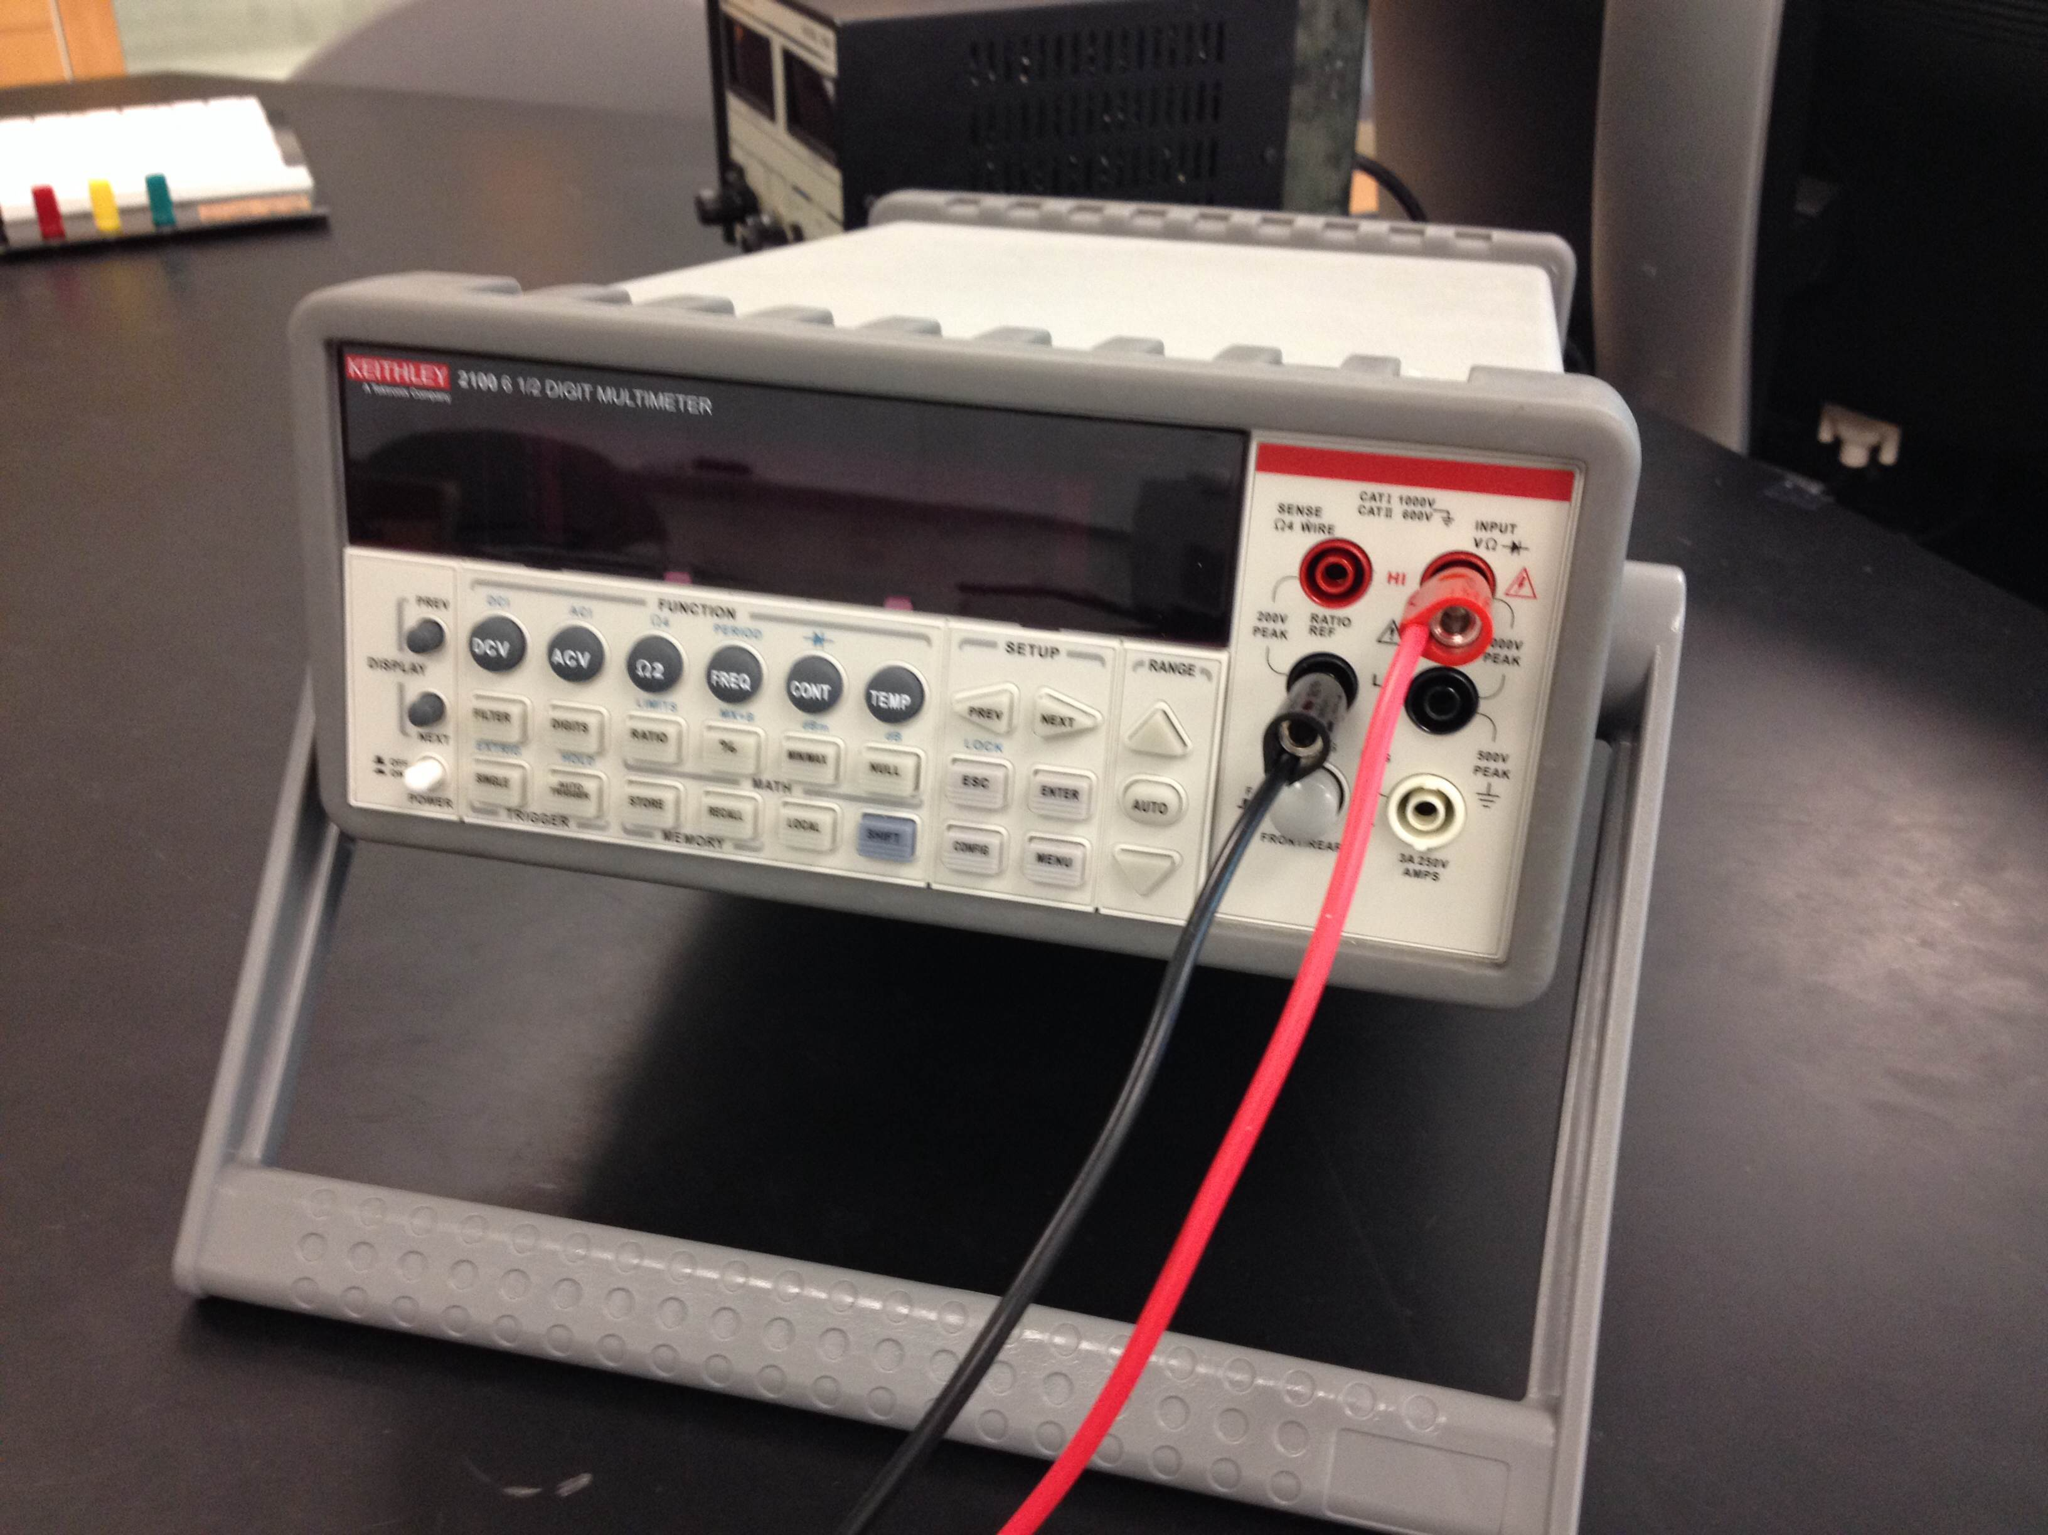
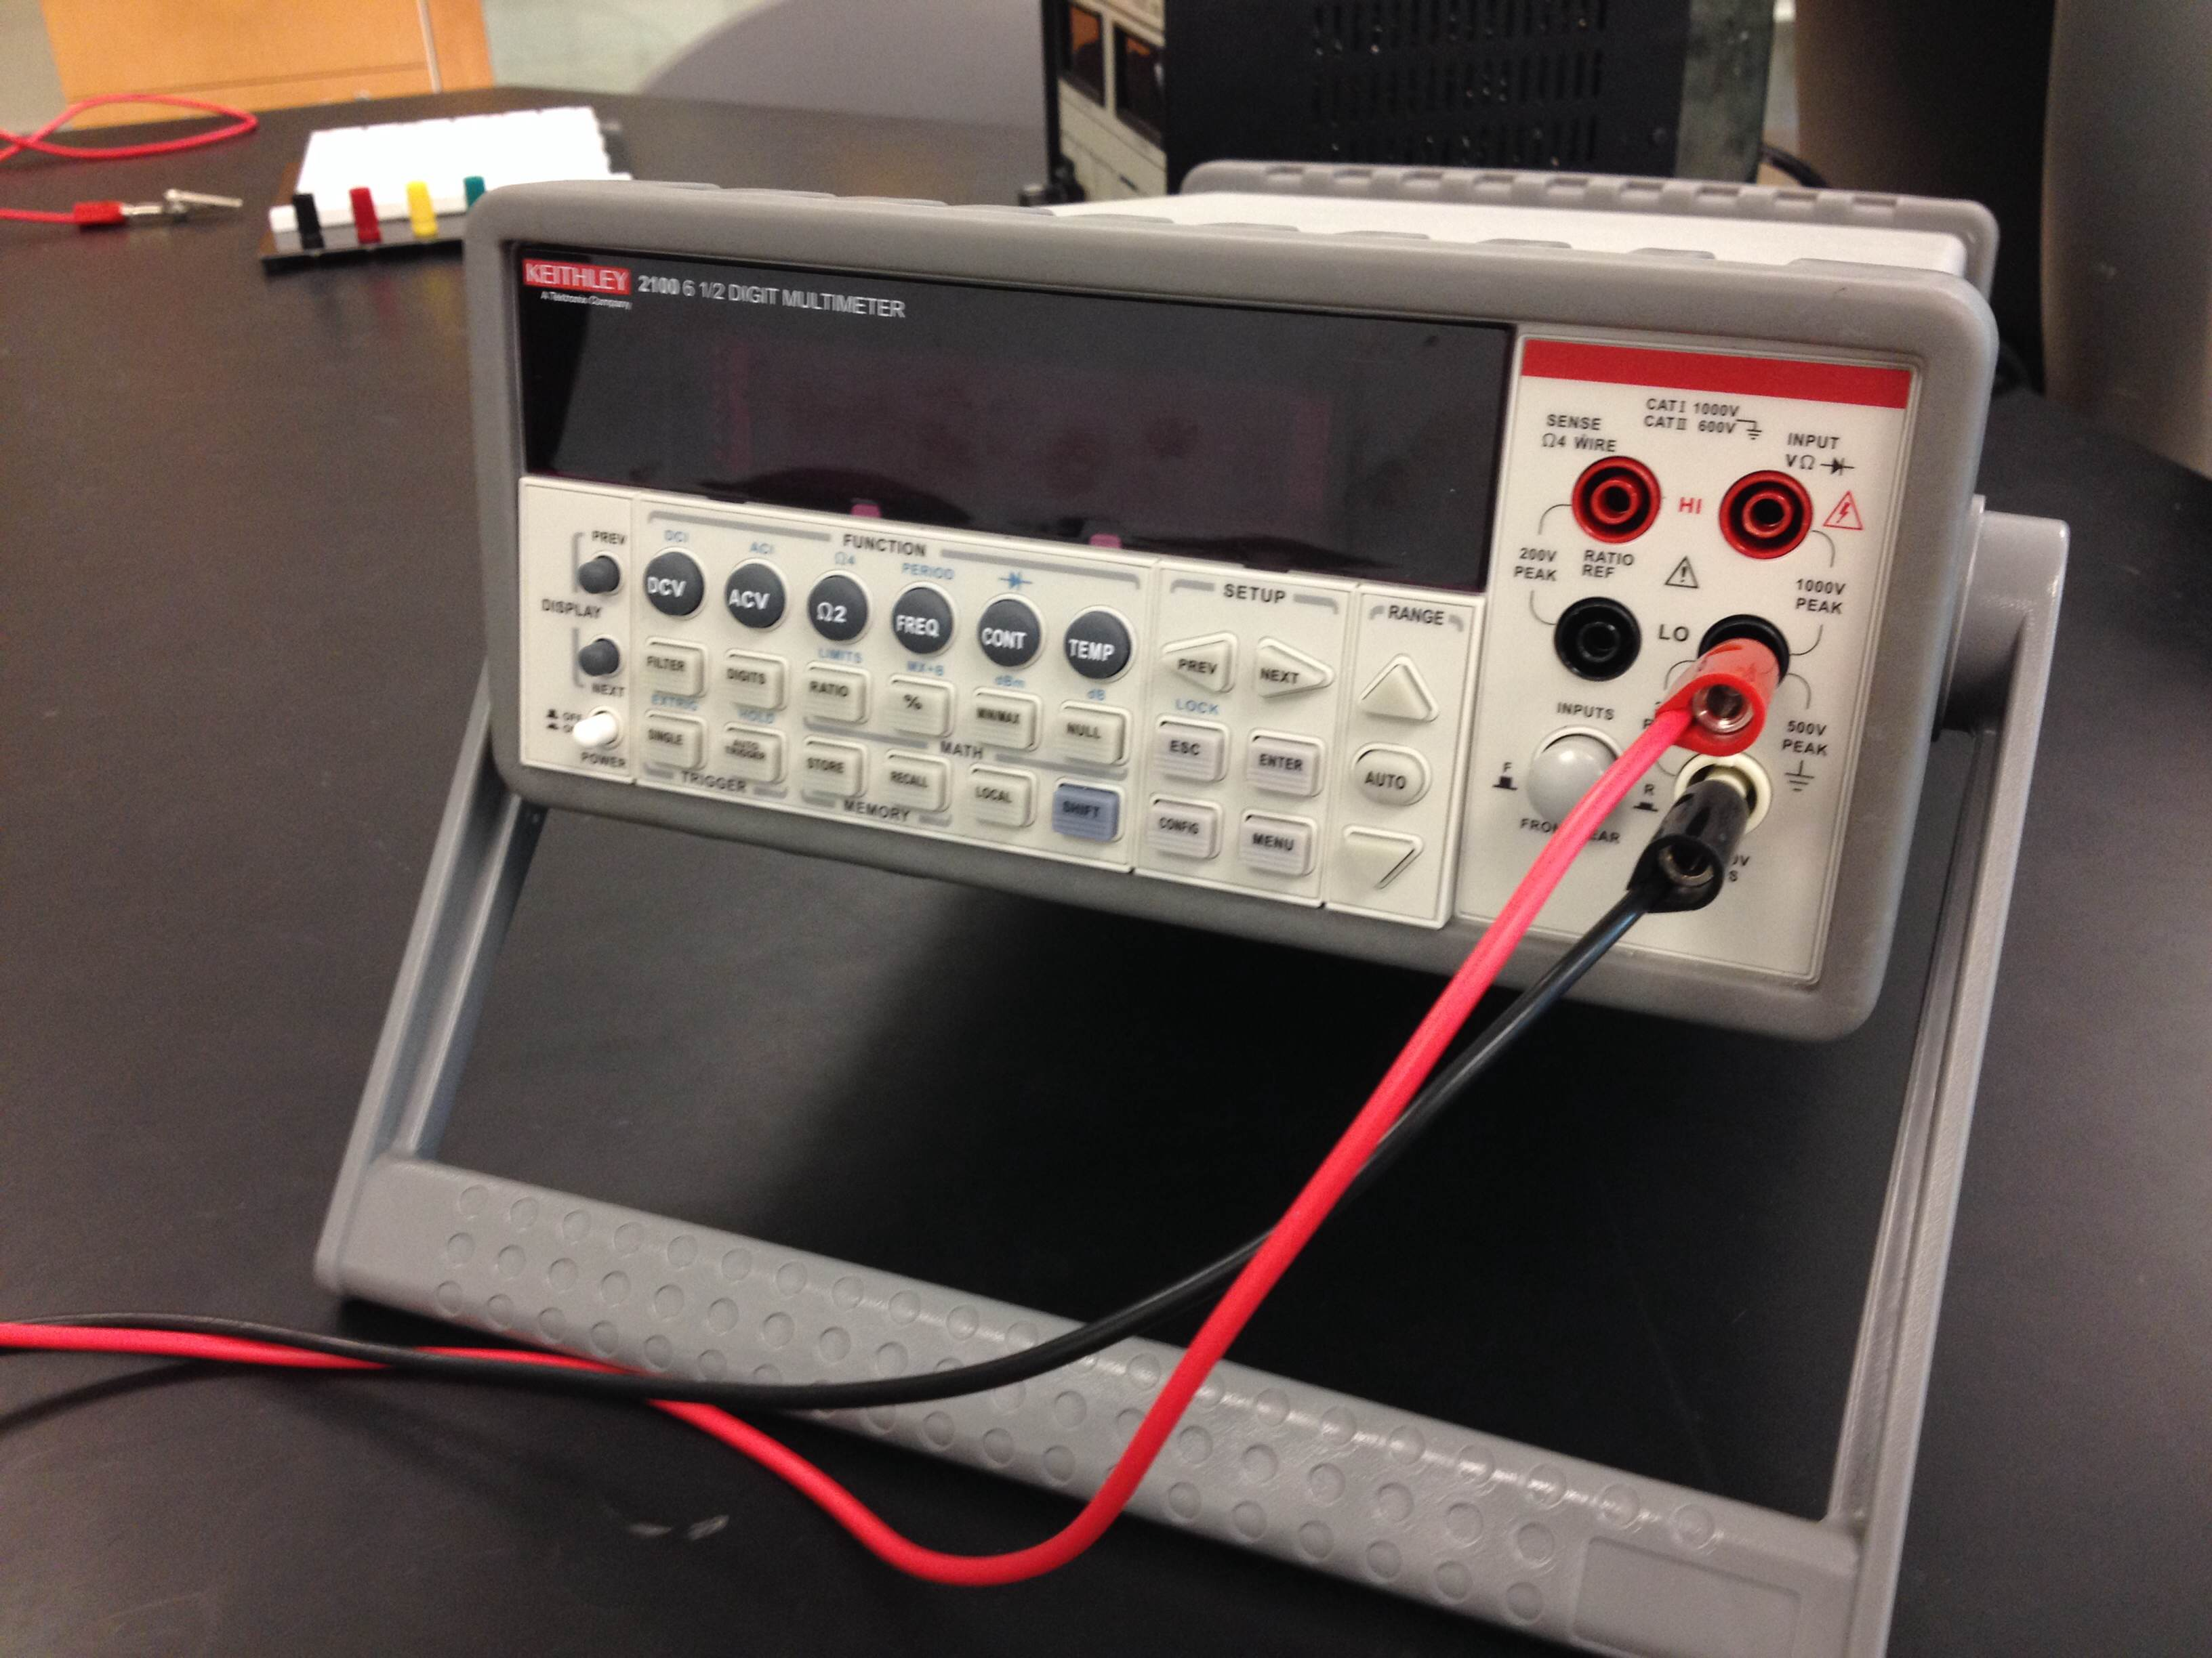
Keithley Multimeter
Keithly Multimeters are capable of measuring voltages and currents with more accuracy.
Hit the shift key, and then the DCV button to measure Current.
This setting will allow you to measure voltage.

Slide 9

Before We Begin
It is very easy to break circuit equipment!
Before turning on your power supply, make sure that the voltage is all the way down. ie turn it down yourself to make sure, don’t just look at it.
While the LED is in the board, do not Exceed 2 Volts.
Never exceed 10 Volts during this lab.
Things Can Happen:

Slide 10
How is a Breadboard Connected?
Use the handheld multimeter to test out how the bread board is connected.
Put the multimeter into Continuity test setting.
Place cables into the multimeter and connect alligator clips.
Use two wires to probe the different holes and draw a schematic of how the board is connected?
Are the top power connections labeled V_{a}, V_{b}….etc. connected to the board?

Slide 11
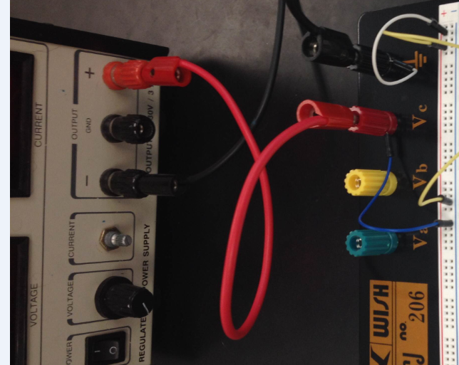
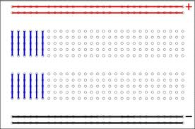
How is a Breadboard Connected?
So have found that the board is connected like this.
Now we are going to build a simple circuit.
Connect the power supply as shown.
These are called the power rows. Connect the power supply to these rows. One terminal for each row.

Slide 12
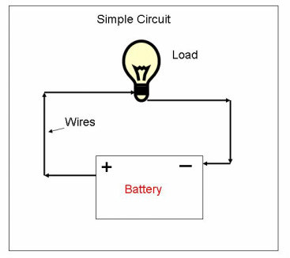
LED Circuit
Use your knowledge of how the board is connected to construct this circuit.
The light-bulb is the red LED and the battery is the power source.
Before turning on your power supply make sure it is turned all the way down.
DO NOT EXCEED 2 Volts.
You will know that you have built it correctly if the LED lights up.

Slide 13
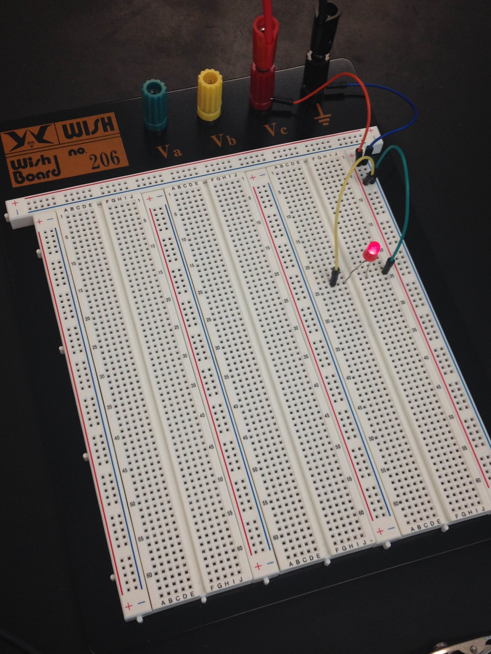
LED Circuit
Some variation of this is what you have created.
Now to measure Voltage and current.
Do not disconnect your circuit.

Slide 14
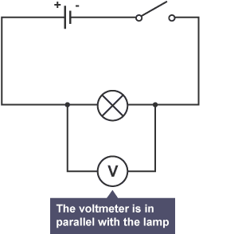
Measuring Voltage
Voltage is measured in parallel to the element for which you want to know the potential difference.
When place parallel to the element, the voltmeter will have the same potential drop across the ends.
Use the Handheld Multimeter to measure the voltage across the LED.
Now Use the Keithley multimeter to measure the Voltage.
Was there a difference?

Slide 15
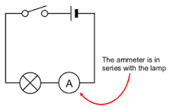
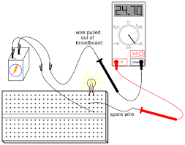
Measuring Current
Now we will measure the current through the LED.
Current is measured in series with the circuit. You must break you circuit and insert the Ammeter.
The reason you must do this is so that the same amount of charge (ie current) will be passing through your multimeter.
First use the Handheld multimeter to measure current.
Next use the Keithley. Was there a difference.
Leave the Keithley connected in series. We will use it for the next part.

Slide 16
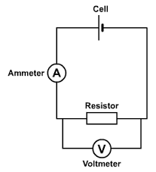
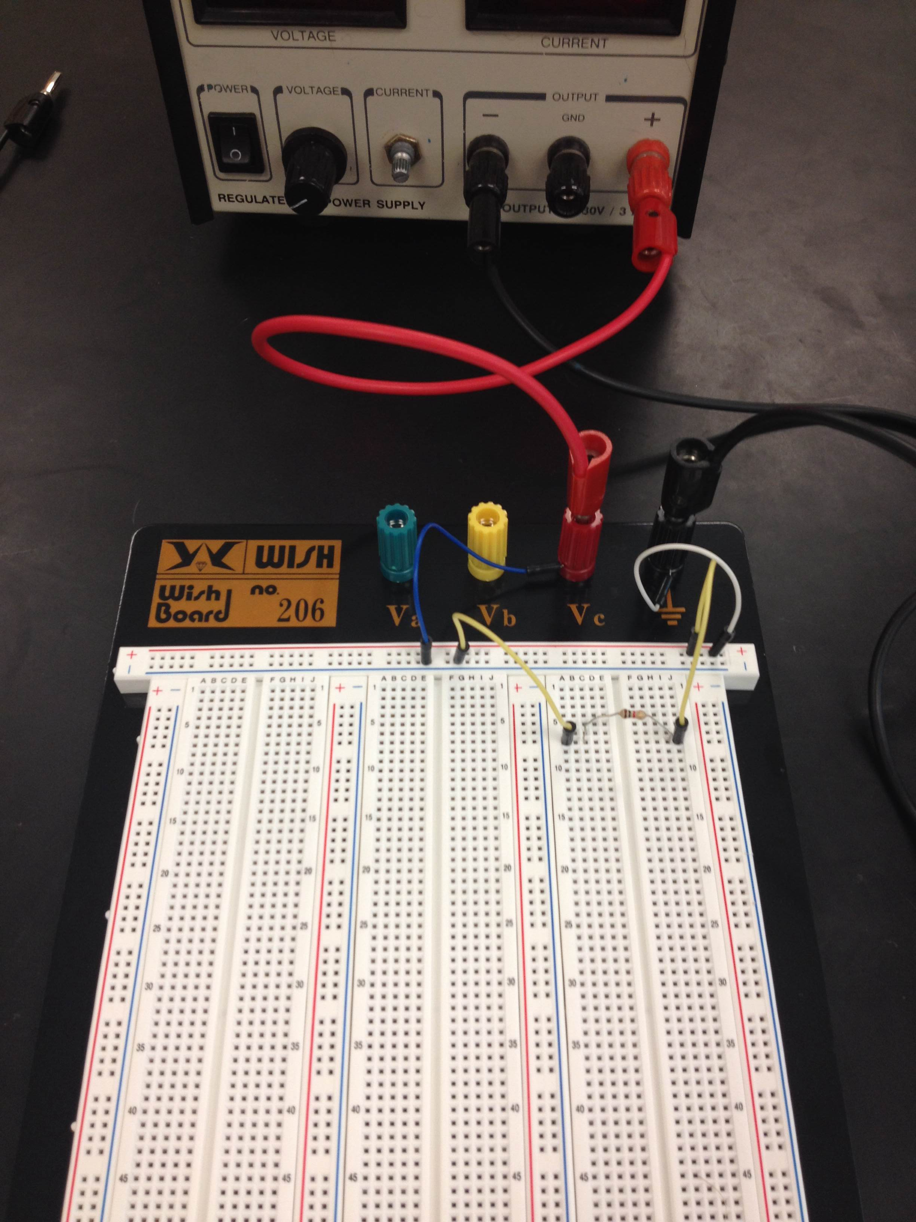
Verifying Ohm’s Law
I have handed out unknown resistors. Take your unknown resistor and replace it with the LED in your circuit.
Start with a low voltage (less than 1V) and take both current and voltage measurements. NOTE: You can take these measurements simultaneously.
Use the Handheld multimeter to measure the Voltage across the resistor, just as you did for the LED.
The Keithley should still be connected to measure current.
Plot your results using Ohm’s Law. Make the slope of your data the resistance of your resistor.
You can be very accurate in current readings with the Keithley!

